Slide 1

BitcoinBabes-IITKGP Hackathon
Team: Vishal Rao, Rahul Gopalan

Slide 2
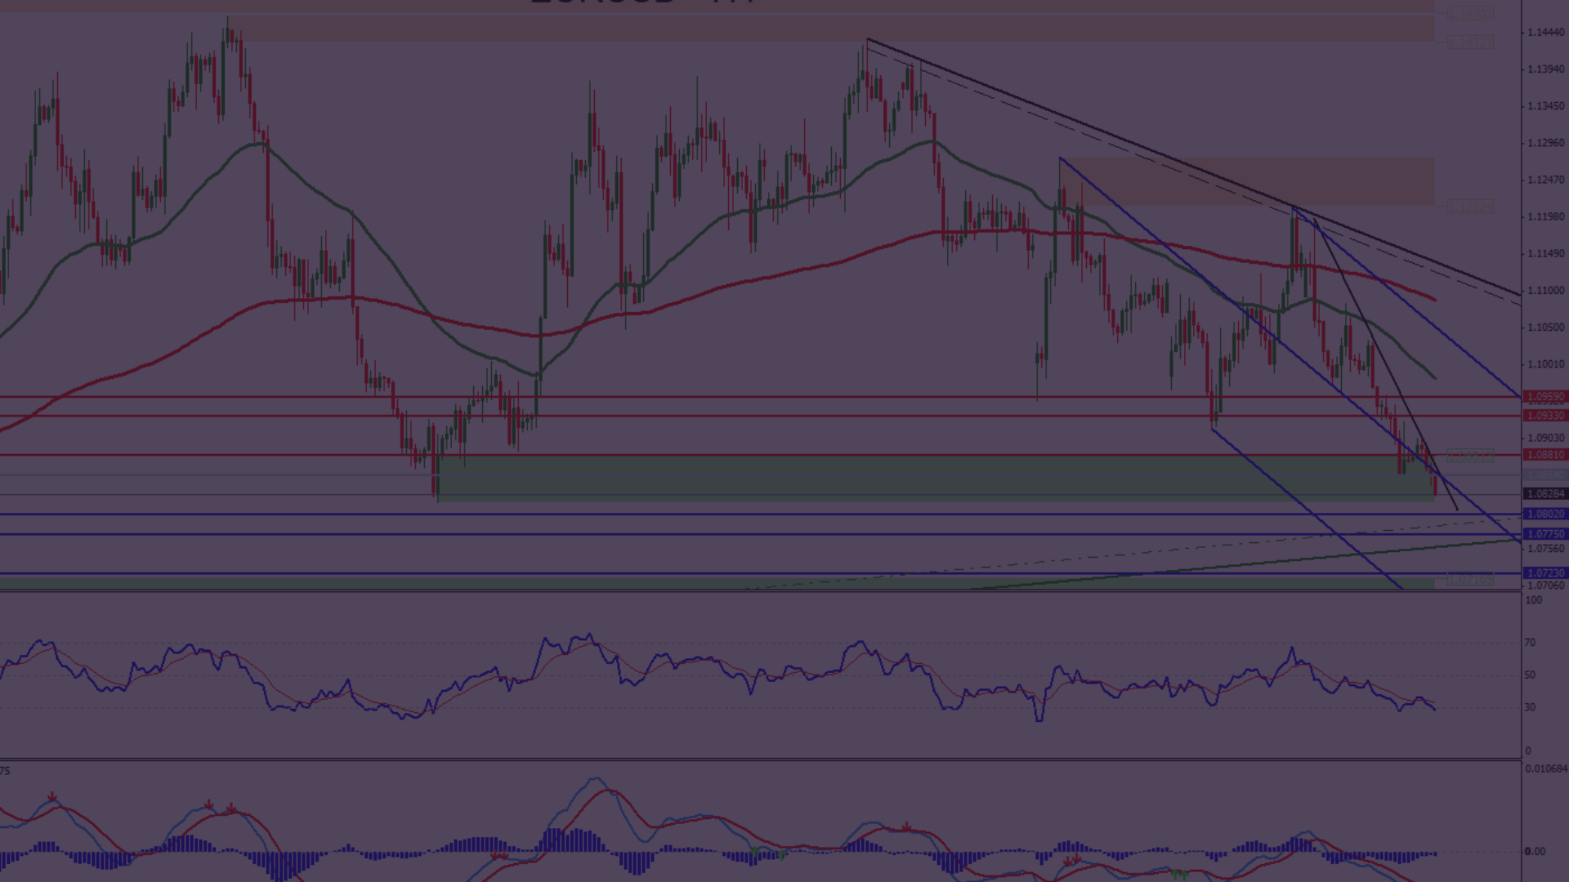
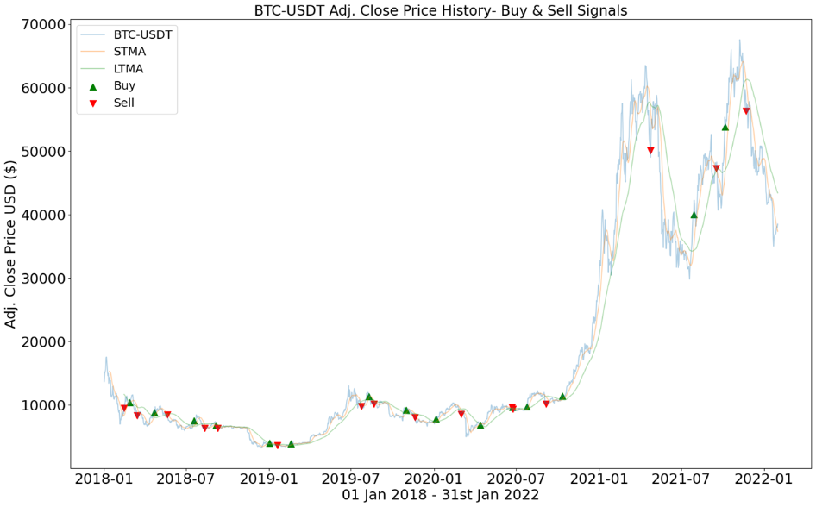
Approach 1: Technical Analysis
Implemented Strategy
Success Rate
Implemented a golden crossover strategy with a short-term moving average of 12 days and a longer-term moving average of 45 days.
The model could hardly be called a success, and only delivered around $60,000 over the four-year period after testing out various pure technical analysis methods.

Slide 3

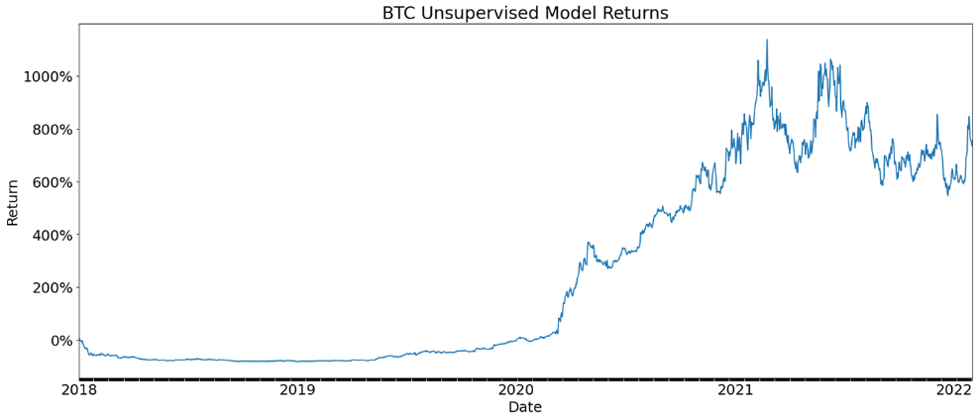
Approach 2: GARCH Machine Learning Model
GARCH Statistical Modelling
Model's Performance
Volatility Prediction
While the returns on the model were impressive, the drawdowns and general volatility of the returns made it less favourable.
Due to lack of proper scaling of volatility predictions at the end, the model threw away a potential 1000% gain.
Used the GARCH statistical modelling method to predict and forecast the volatility of the BTC/USDT over the four year period. The buy and sell signals were generated by a MACD strategy.

Slide 4
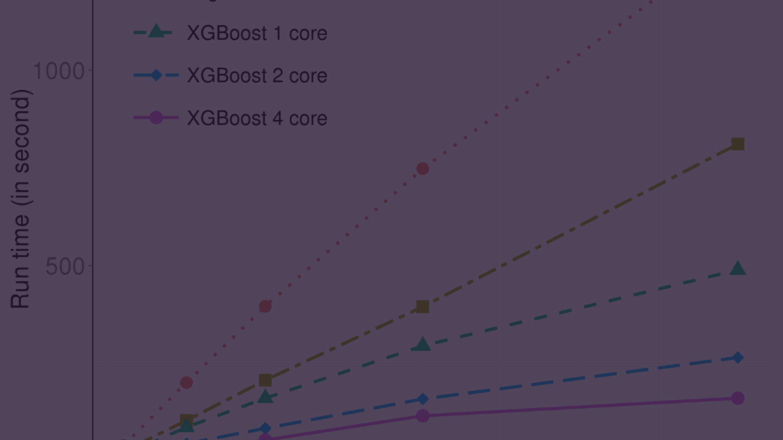
Final Approach: XGBoost Model
1
Strategy
2
Technicals
In our best and last attempt, we used the XGBoost model as a classifier. Using RSI as the sole feature, we used the XGBoost algorithm to classify and generate trading signals based on a moving average crossover strategy.
Based on technical analysis we performed on the BTC/USDT price action during the given period, we established that the optimal time periods for the short-term and long-term moving averages was 24 and 59 days respectively.

Slide 5
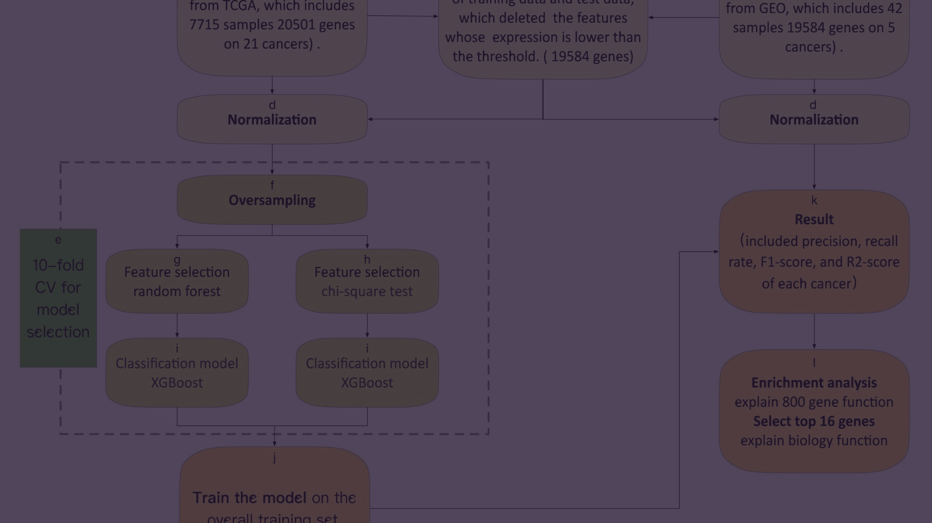
How Does it Work?
1
Signal Generation
First, we generate buy and sell signals based purely on a moving average strategy.
A buy signal was signified by the 24-day moving average crossing over the 59-day moving average, and the sell signal was signified by the reverse.
2
Model Training
sklearn’s SimpleImputer was used to handle missing values in the moving average columns (using calculated means). The completed dataset was then fed into the XGBoost machine learning model for training.
The model was trained with Relative Strength Index (RSI) as a feature, calculated over 14-day period.
To make our prone to overfitting, we decreased the test size of the training data we fed into the model.
In the light of outlier data, we increased the number of estimators slightly to account for more feature permutations, and decreased the learning rate to further generalize the algorithm. This also helped us avoid missing a potential optimal solution.

Slide 6






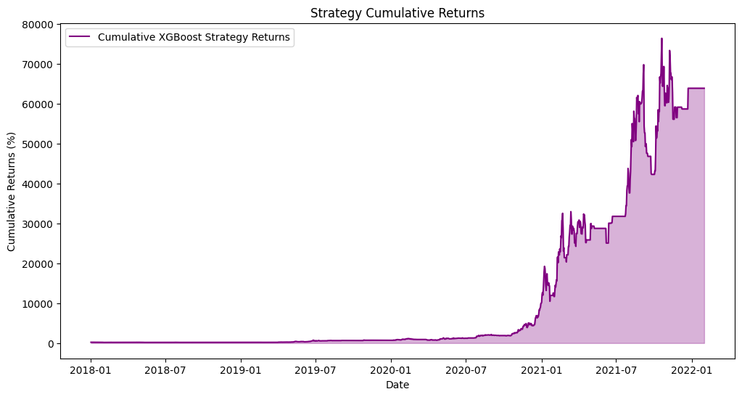
The Results.
Net Profit
Total Closed Trades
Win Rate
63,663.02%
706
56.798%
Sharpe Ratio
Sortino Ratio
1.777
1.915

Slide 7

So, How Good Are We?
Let's look at some generally accepted benchmarks for outperformance and see how we did in comparison.
If we invested $100,000 in the Nifty 50 Index in 2018, we would have $162,650 at the end of the investment period.
With the S&P500, we would have $238,000.
Jim Simons, with his impossible return of 66% year over year, would have $759,333.
And with this algorithm, we would have $63,663,029.

